Slide 1

Dr. L. B .COLLEGE

Slide 2

LIBRARY MANAGEMENT SYSTEM presented by k. bharathi devi

Slide 3
LIBRARY MANAGEMENT SYSTEM
This Project is Library Management System. It includes all Library works, such as Maintaining Books and Members details, Issue Books, returns from the Members and collect the fine, its depending upon the library rules at the end of the day generate Issue and Return reports. These works are done by the Librarian.
The Book and Member details are maintaining on a Database. So we need not maintain several records to store the details and if we want to any particular Book or Member details, it will be very easy to search.

Slide 4
Software Requirements:
Web Presentation : CSS
Client – side Scripting : JavaScript
Programming Language : Java
Web based Technologies : Html, Servlets
Database Connectivity : JDBC
Java Version : JDK 1.6
Backend Database : MY SQL
Operating System : Windows7/ XP/2000/2003,LINUX
Web Server : Tomcat 7.0
Browser : Mozilla Firefox

Slide 5
HARDWARE REQUIREMENTS
Hardware Requirements:
Pentium processor :233MHZ
RAM Capacity :128MB
Hard Disk :20GB
Monitor :15’’Color Monitor

Slide 6
About database
Introduction to Backend:
MySQL Database
MySQL is a fast, easy-to-use RDBMS used being used for many small and big businesses. MySQL is developed, marketed, and supported by MySQL AB, which is a Swedish company.
JDBC :
One can write a single program using the JDBC API, and JDBC is a java API for executing SQL, Statement Nevertheless, JDBC is often thought of as standing for java Database Connectivity. It consists of a set of classes and interfaces written in the Java Database Connectivity. JDBC provides a standard API for tool/database developers and makes it possible to write database applications using a pure Java API.

Slide 7
Table names
bookentry
clerkinfo
issues
pages
returns
staffentry
studententry
users
userspagesmapping

Slide 8
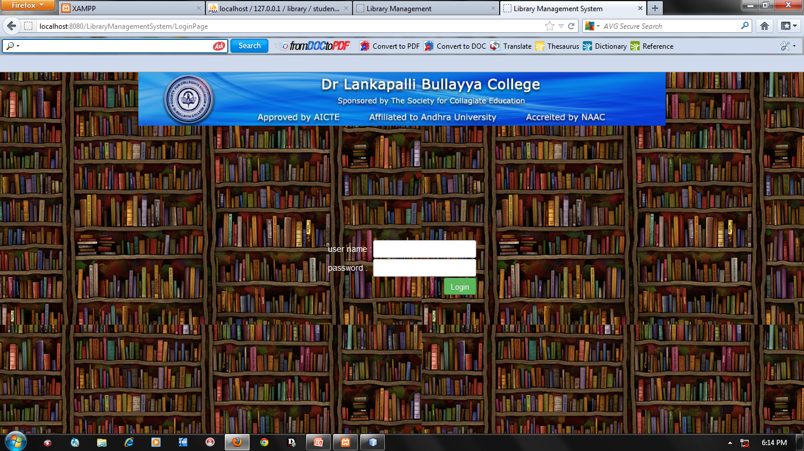
LOGIN FORM:

Slide 9
USERS: Admin & Clerks

Slide 10
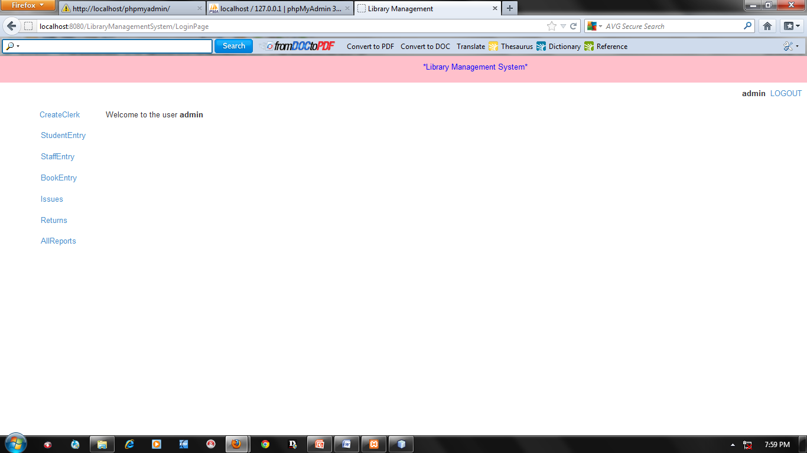
HOME PAGE

Slide 11
Admin functionalities
Create Clerk
Book Entry
Staff Entry
Student Entry
Book Issues
Book Returns
Fine collection
All Reports

Slide 12
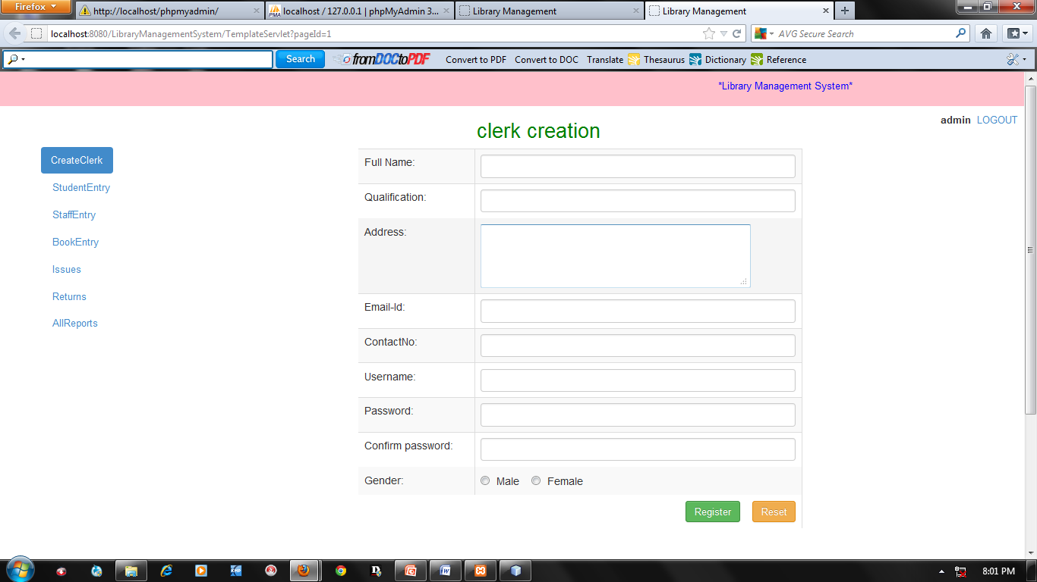
CLERK REGISTRATION FORM

Slide 13
Clerk Functionalities
Book Entry
Student Entry
Staff Entry
Book Issues
Book Returns
Fine Collection

Slide 14
Clerk Creation
INPUTS: FullName,Qulification,Username,password etc.
OUTPUT:-
Created clerk successfully
Edit clerk successfully
Updated clerk successfully
VALIDATION:
If we are submit without filling details, then it will show “please fill all the details”.

Slide 15
Book Entry
INPUTS: Title, Author, subject….etc.
OUTPUT:
Data stored successfully
Edit Book successfully
Updated Book successfully
VALIDATION:
If the Book is edit then it will show the total No. of Books and how many Books are issued.

Slide 16
Student Entry
INPUTS: Name, Branch, Admission No etc.
OUTPUT:
Student Entry successfully
Student Entry Edit Successfully
Student Update successfully

Slide 17
Staff Entry
INPUTS: Name,Designation,……..etc.
OUTPUT:
Staff Entry data stored successfully
Staff Edit successfully
Staff Update successfully

Slide 18
Book Issues
INPUTS:Member Id,Book Id,….etc.
OUTPUT:
Book Issued successfully.
For every student 3 books issued only.
For every staff 5 books issued only.
Validation:
If Books are over, it will displays already all books are issued.
Same Book can’t be issued twice.
Some limitation of Books are issued to the member.

Slide 19
Book Returns
INPUTS:Member Id, Book Id,……etc.
OUTPUTS:
Book Returns successfully.
The Book Return with in 15 days.
Validation:
For Student: If Book issued date is greater than 15 days than Fine will shown on the screen.
For Staff: There is no Fines for Staff.

Slide 20
For All Reports
INPUT:
Today’s Report
Weekly Report
Monthly Report
Year Report
Between dates
OUTPUT: All Reports showed successfully.

Slide 21
Conclusion:
Every Project is done to explore a new solution for a given problem. This project provides a solution to the librarian to make their works easy. This Computerized Library Management System reduces the number of people needed to do the library works and it reduces the amount of time needed to complete the work.

Slide 22
Future enhancements:
Limits:
Current Project does not support Barcode System.
Current project does not support Images upload.
Enhancements:
Introduce Barcode System.
It extends the stores the library stock details and magazines etc.

Slide 23
Copy rights reserved
BY
Dr.L.BULLAYYA COLLEGE

Slide 24

THANKING YOU

